Slide 1

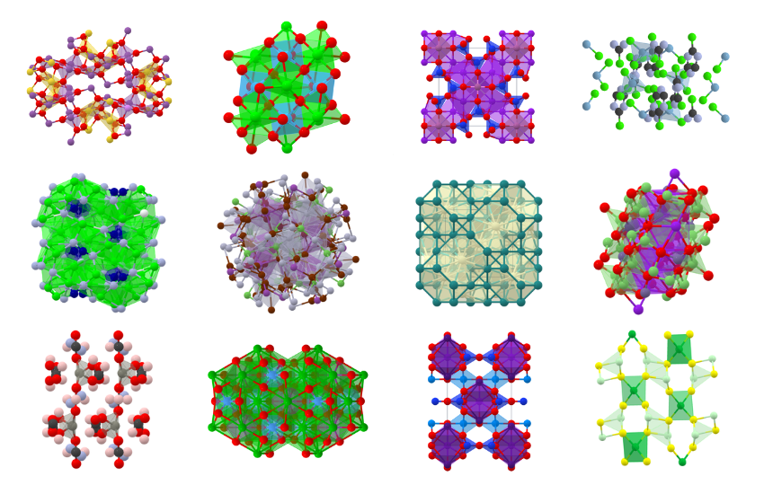


AI 4 Materials Design
Caleb Morgan; Solomon Boakye-Yiadom
Mechanical Engineering
York University
September 3, 2025

Slide 2
Course Objective
To provide a comprehensive introduction into the application of machine learning to the design and discovery of new materials
Conceptual & mathematical foundations
Examples & case studies
Hand-on practice

Slide 3
Learning Outcomes
At the conclusion of this course, the student should be able to:
Recognize, define and describe key concept in machine learning approaches of relevance to materials science.
Analyze and understand given data pertaining to a materials science problem.
Apply machine learning algorithms for understanding structure-property relations in materials science, and materials design and discovery
Integrate above knowledge to solve practical materials science problems using machine learning and demonstrate it through projects and research

Slide 4
Pre-requisites
Knowledge of basic statistics (e.g., statistical distributions, Bayes’ theorem, regression etc.)
Knowledge of basic linear algebra (e.g., matrix multiplications, eigen value decompositions, inverses)
Some programming experience, ideally Python
Knowledge of materials structure and property concept

Slide 5
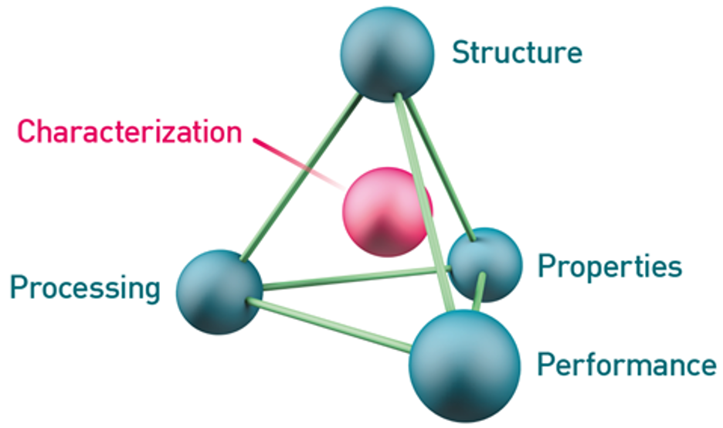
Essential Work of Materials Science
Materials Science develops the fundamental understanding of relationships and structure of materials
Materials Engineering uses this understanding to engineer (design) materials for real-life application

Slide 6
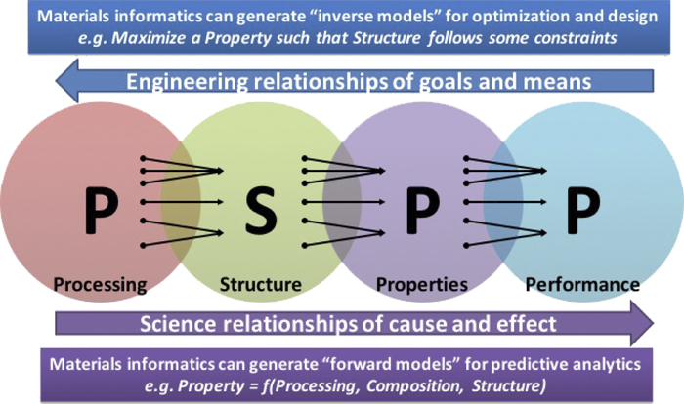
PSPP Relationship of Materials
Agrawal, A., & Choudhary, A. (2019). Deep materials informatics: Applications of deep learning in materials science. MRS Communications, 9(3), 779–792. https://doi.org/10.1557/MRC.2019.73/FIGURES/6

Slide 7
Materials Development by Era
Different eras in human history are named after the materials incorporated in the predominant technologies
2.5M – 3000 BCE
Obsidian, flint, + animal hide, bone, wood, found hydrocarbons
1200 BCE – 300 CE
Iron, + steel, glass, processed minerals
1300 – 1950 CE
Steel, + aluminum and other metals, alloys of same, synthetic polymers, extracted hydrocarbons
Stone Age
Bronze Age
Iron Age
Middle Age
Industrial Era
Info. Age
3000 – 1200 BCE
Bronze, + clay ceramics, papyrus, gold, silk, rubber
300 – 1300 CE
Porcelain ceramic (Far East), + ceramic glazes, lacquer, metal/ceramic composites
1950 CE - ???
Silicon, + modern composites, polymers, nanostructured materials “metamaterials”

Slide 8
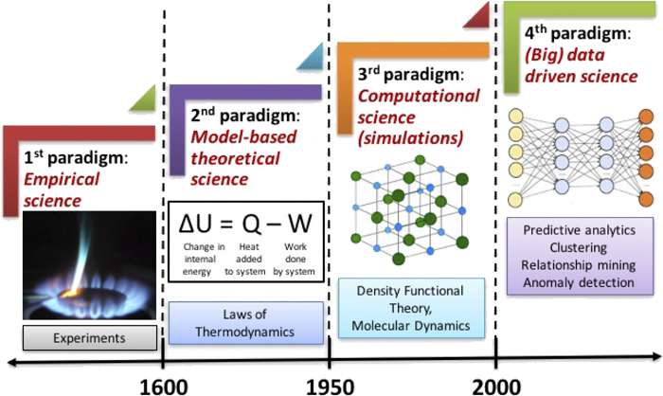
Materials Science Paradigms through Ages
Agrawal, A., & Choudhary, A. (2019). Deep materials informatics: Applications of deep learning in materials science. MRS Communications, 9(3), 779–792. https://doi.org/10.1557/MRC.2019.73/FIGURES/6

Slide 9
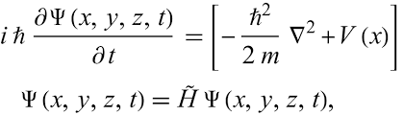

Materials Science from “First-Principles”
Generally applicable to any chemistry
Material Properties
Schrodinger Equation
Inherently scalable
Phase stability
Diffusion barriers
Surface energies and Wulff shape
Material properties
Electronic structure
Charge densities
Density functional theory (DFT) approximation

Slide 10
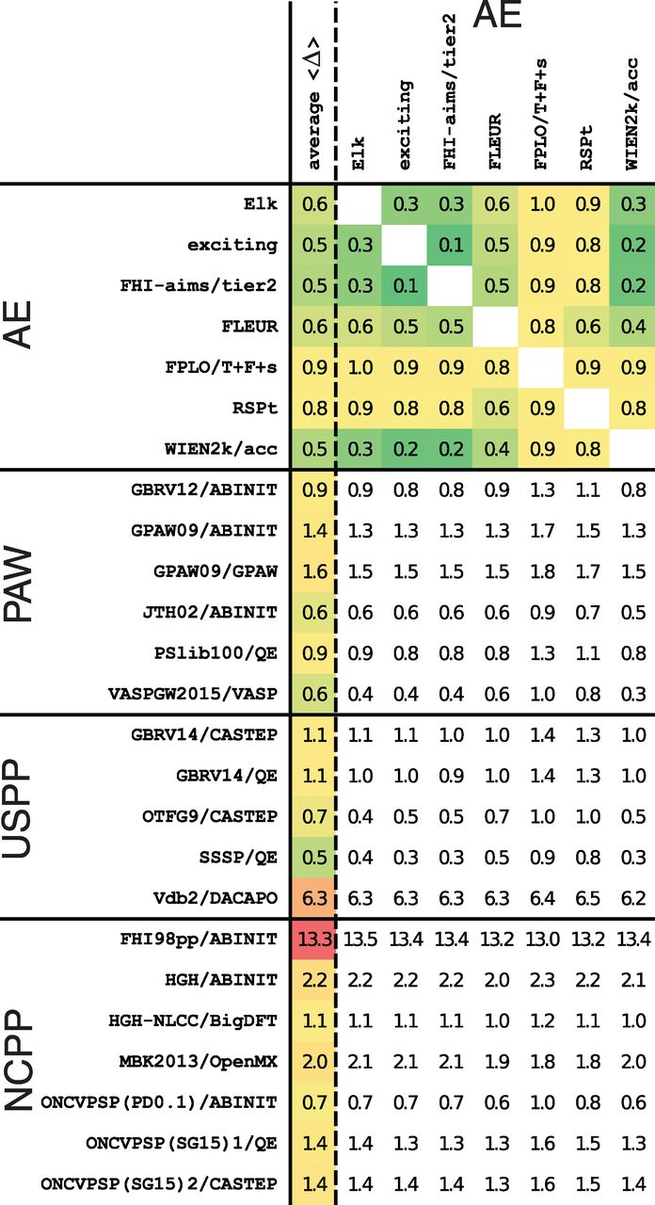
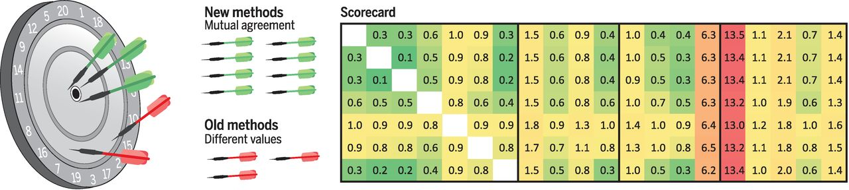
Materials Science Paradigms through Ages
Lejaeghere, K., Bihlmayer, G., Björkman, T., Blaha, P., Blügel, S., Blum, V., Caliste, D., Castelli, I. E., Clark, S. J., Dal Corso, A., de Gironcoli, S., Deutsch, T., Dewhurst, J. K., di Marco, I., Draxl, C., Dułak, M., Eriksson, O., Flores-Livas, J. A., Garrity, K. F., … Cottenier, S. (2016). Reproducibility in density functional theory calculations of solids. Science, 351(6280). https://doi.org/10.1126/SCIENCE.AAD3000/SUPPL_FILE/AAD3000-LEJAEGHERE-SM.PDF

Slide 11
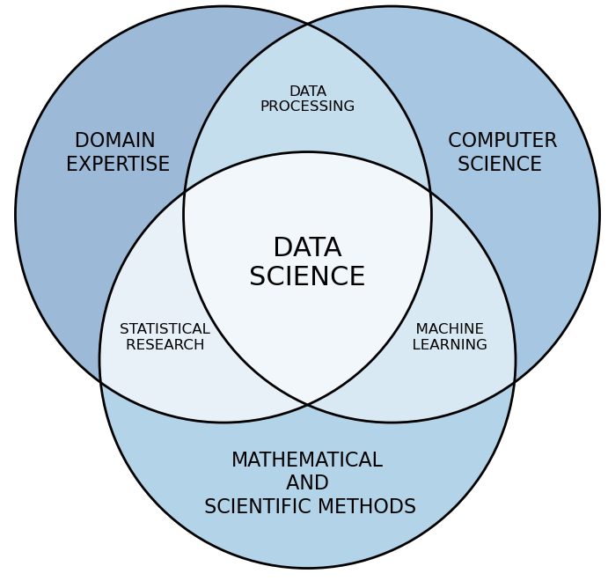
Where does Data Science lie?

Slide 12
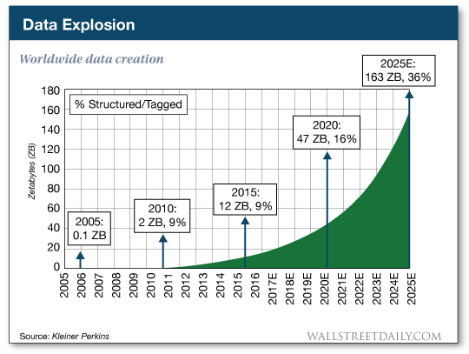
Data Explosion

Slide 13
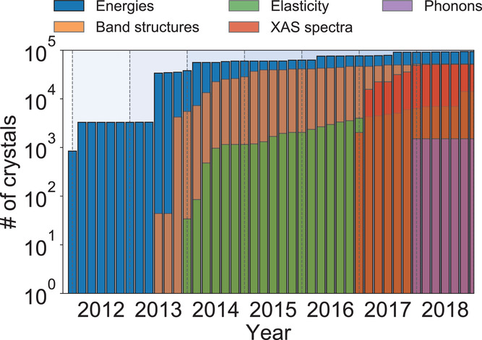
Expanding Database of “computed” properties
Chen, C., Zuo, Y., Ye, W., Li, X., Deng, Z., Ping Ong, S., Chen, C., Zuo, Y., Ye, W., Li, X., Deng, Z., & Ong, S. P. (2020). A Critical Review of Machine Learning of Energy Materials. Advanced Energy Materials, 10(8), 1903242. https://doi.org/10.1002/AENM.201903242
Number of crystal structures with various properties computed in Materials Project since inception

Slide 14
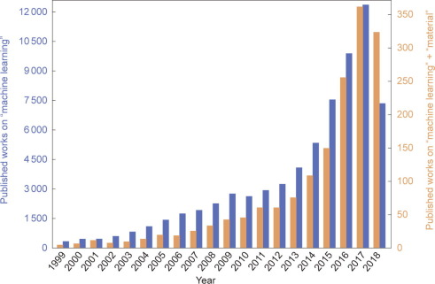
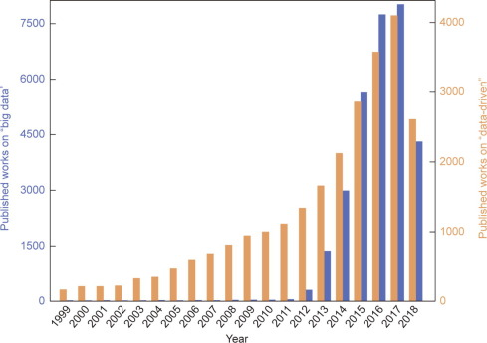
ML & Big Data
Number of published works on “machine learning” and “machine learning” + “material” (from January 1999 to September 2018)
Number of published works on “big data” and “data-driven” methods (from January 1999 to September 2018)
Zhou, T., Song, Z., & Sundmacher, K. (2019). Big Data Creates New Opportunities for Materials Research: A Review on Methods and Applications of Machine Learning for Materials Design. Engineering, 5(6), 1017–1026. https://doi.org/10.1016/J.ENG.2019.02.011

Slide 15
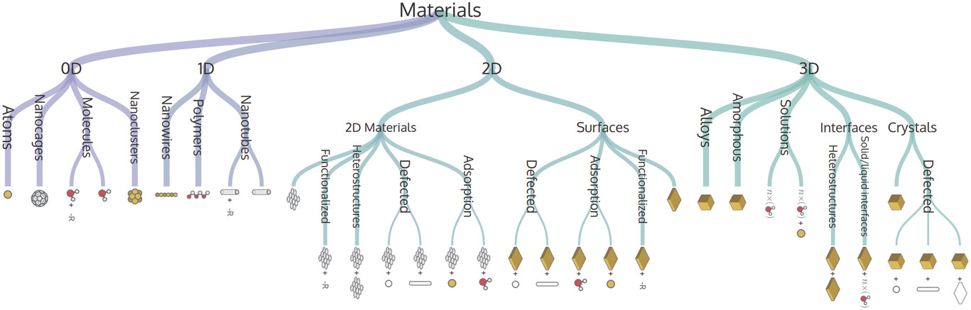
Materials Ontology
Example of an ontological hierarchy for the structural characterization of materials: a materials tree of life.
Himanen, L., Geurts, A., Foster, A. S., & Rinke, P. (2019). Data-Driven Materials Science: Status, Challenges, and Perspectives. Advanced Science, 6(21), 1900808. https://doi.org/10.1002/ADVS.201900808

Slide 16
Basic Machinery of Machine Learning in Materials Design

Slide 17
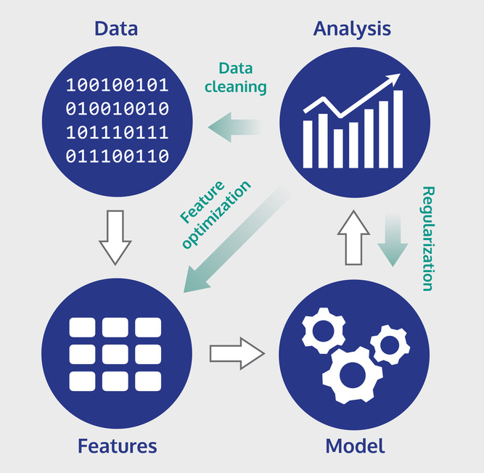
Key Steps in Building a ML Model
Himanen, L., Geurts, A., Foster, A. S., & Rinke, P. (2019). Data-Driven Materials Science: Status, Challenges, and Perspectives. Advanced Science, 6(21), 1900808. https://doi.org/10.1002/ADVS.201900808
Key steps in building a machine learning model. The white arrows indicate the flow of data; green arrows indicate actions that can be identified and performed after analysis to improve the performance of the model

Slide 18
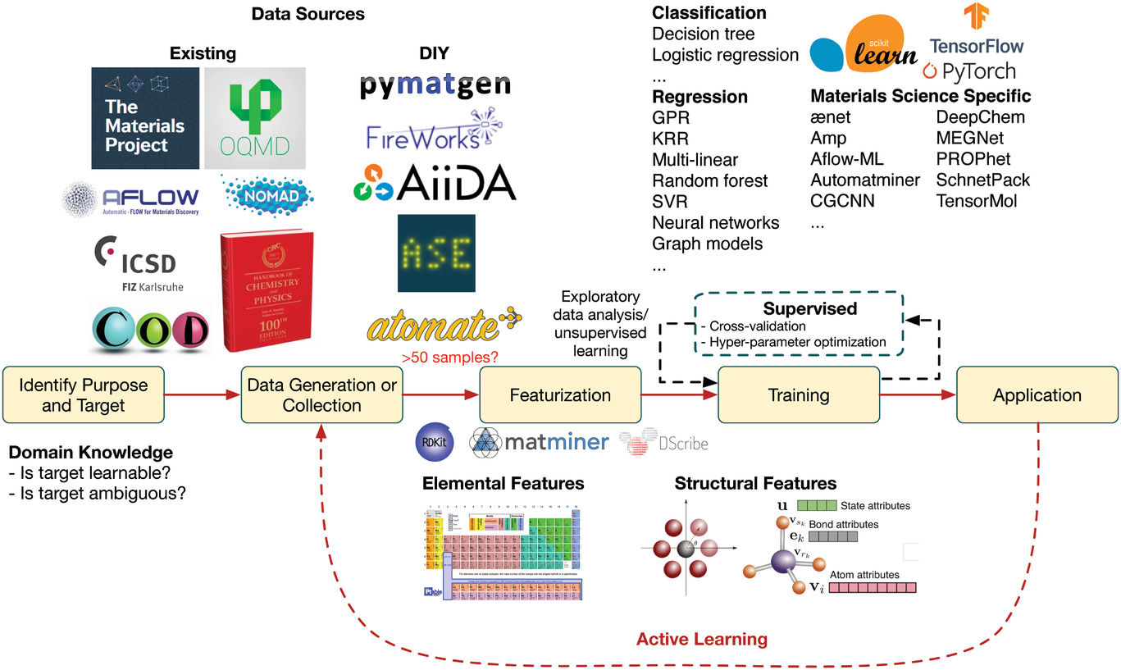
Workflow of ML for Materials Design
Chen, C., Zuo, Y., Ye, W., Li, X., Deng, Z., Ping Ong, S., Chen, C., Zuo, Y., Ye, W., Li, X., Deng, Z., & Ong, S. P. (2020). A Critical Review of Machine Learning of Energy Materials. Advanced Energy Materials, 10(8), 1903242. https://doi.org/10.1002/AENM.201903242

Slide 19
Illustrative examples of application of machine learning in materials science

Slide 20
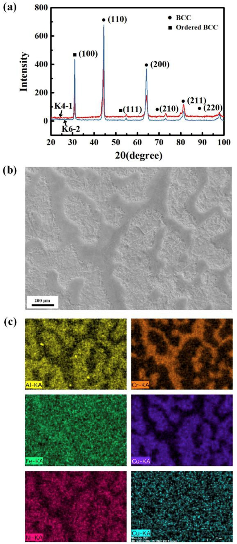
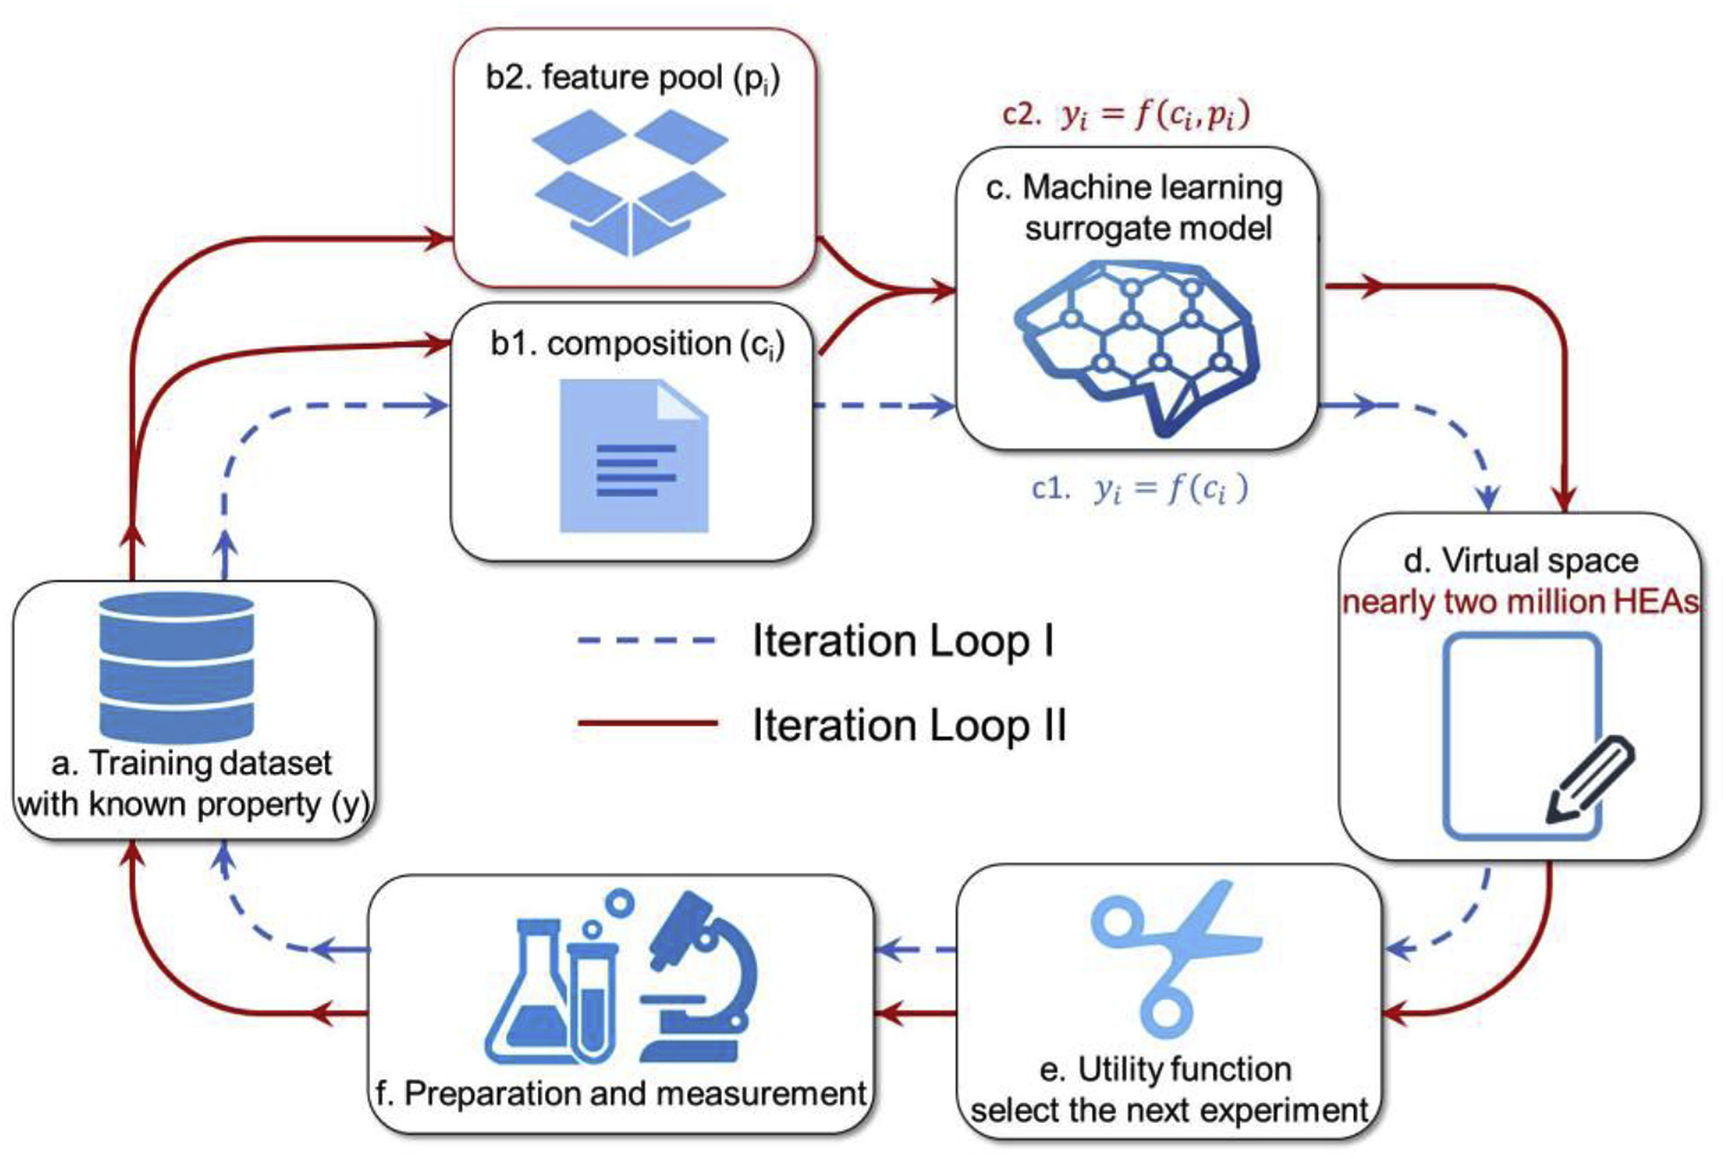
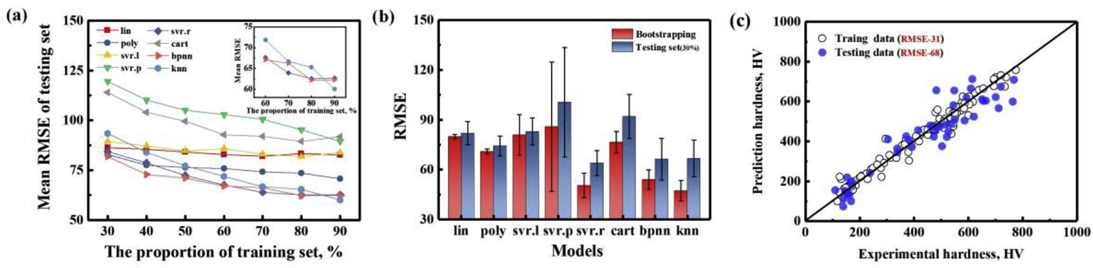
Application area: physical metallurgy (HEA) Property: hardness

Slide 21
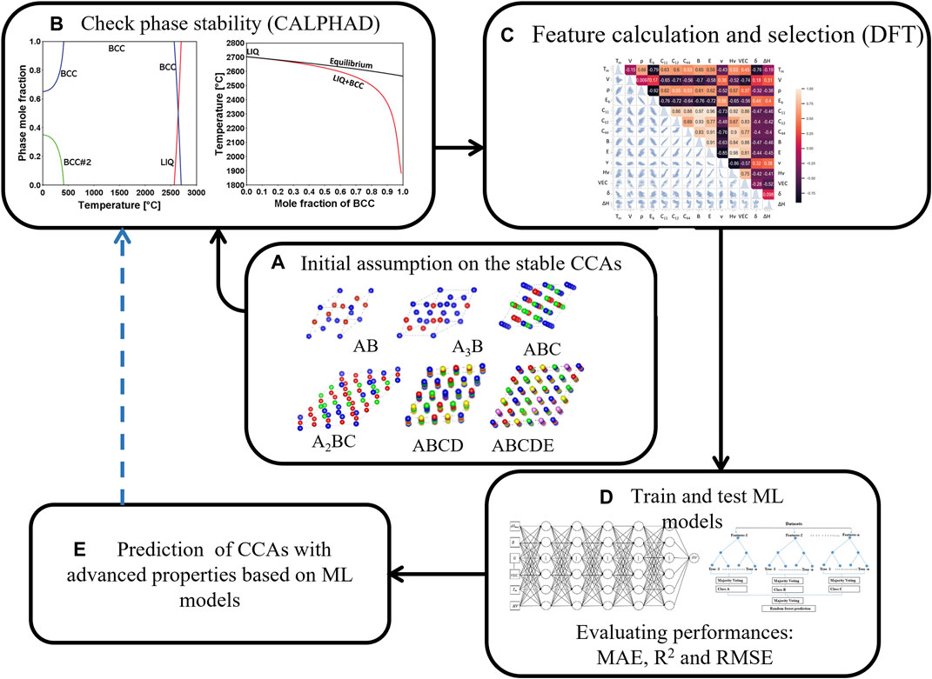
Application area: Refractory CCA
Property: strength at high temperatures, hardness
CALPHAD was used to check phase stability and generate phase diagrams for potential compositions
Employs DFT to calculate material properties and select relevant features correlated with alloy behavior
Zhang, C., Gu, X., Bhandari, U., Lei, J., Guo, S., Kourouma, M., Karoui, A., Yang, S., Pradeep, K. G., & Singh, P. (2022). Machine learning prediction of the mechanical properties of refractory multicomponent alloys based on a dataset of phase and first principles simulation. Frontiers in Metals and Alloys, 1, 1036656. https://doi.org/10.3389/FTMAL.2022.1036656

Slide 22
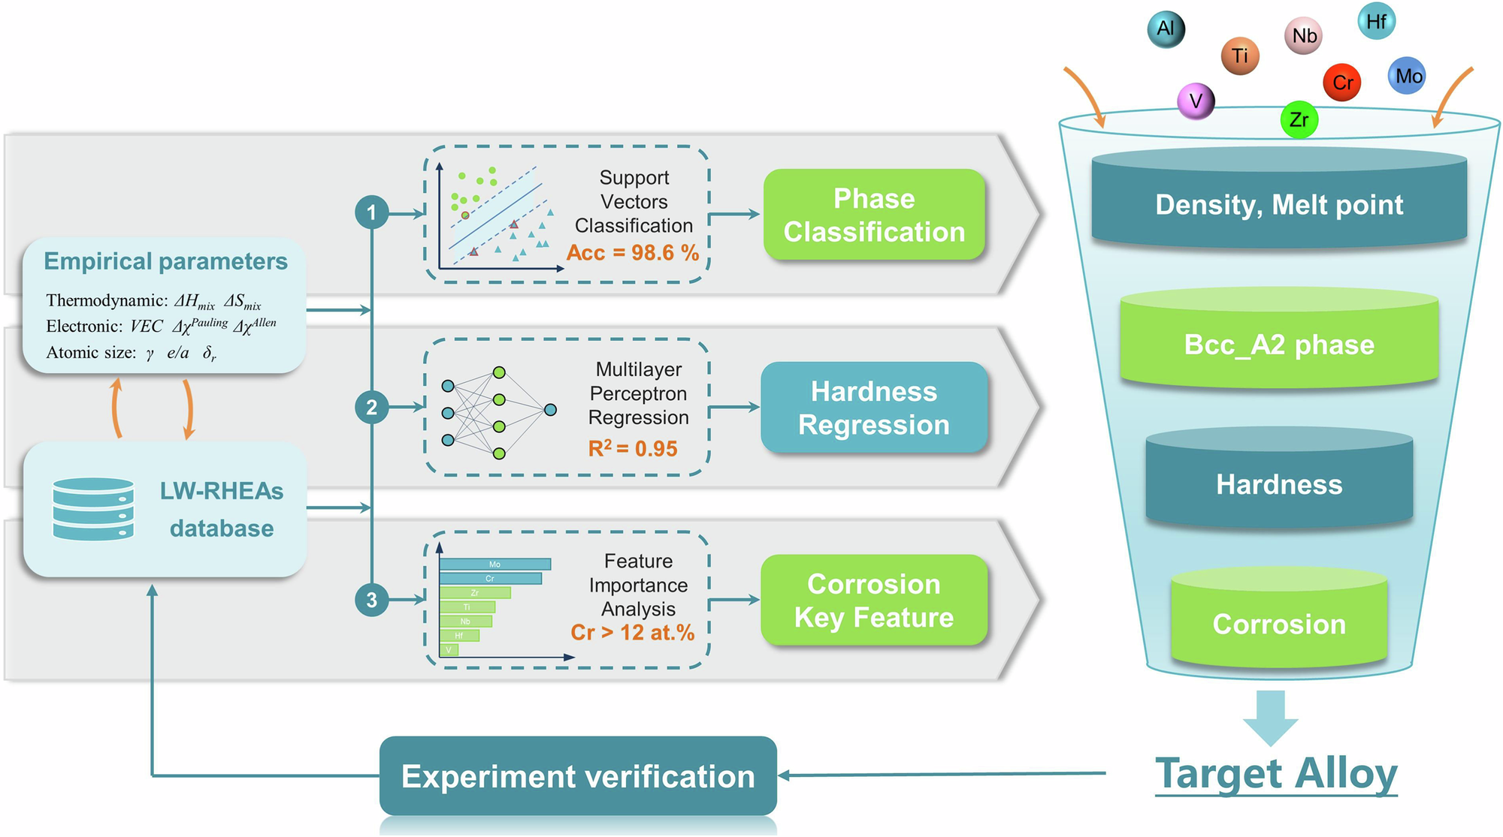
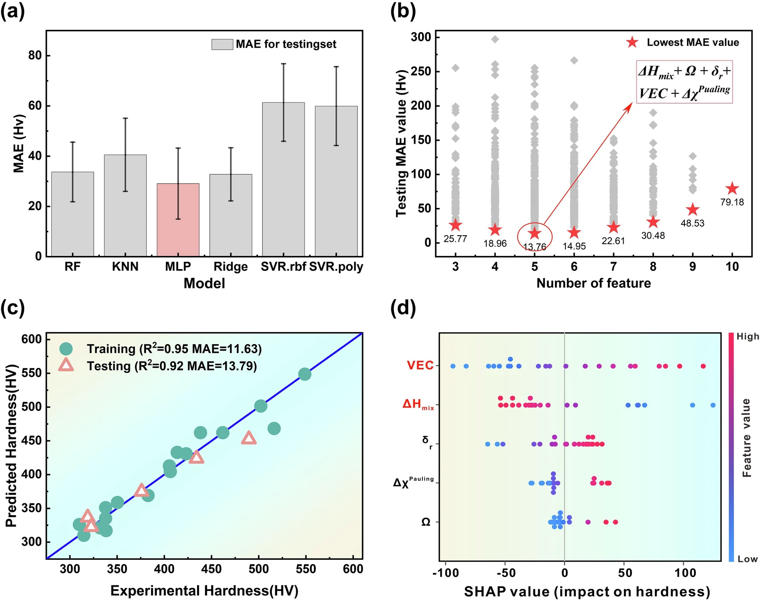
Application area: lightweight refractory HEAs
Property: hardness, corrosion resistance, light weight
Gao, T., Gao, J., Yang, S., & Zhang, L. (2024). Data-driven design of novel lightweight refractory high-entropy alloys with superb hardness and corrosion resistance. Npj Computational Materials 2024 10:1, 10(1), 1–13. https://doi.org/10.1038/s41524-024-01457-6

Slide 23
Module Summary
AI/ML in Materials Science: A relatively new field, emerging within the past 5 years
Rapid Advancement: While machine learning has been a longstanding discipline, its integration into materials science has seen explosive growth over the last decade.
Industry Interest: Despite significant interest from the materials industry, large-scale applications are still in the early stages.
Initial Successes: Early research has yielded promising results in more approachable and foundational areas.
Challenges Ahead: More complex and challenging problems are now being addressed, pushing the boundaries of the field.
Data & Tools Expansion: The development of comprehensive databases and analytical tools continues to fuel growth and innovation.

